Slide 1
PHYSIOLOGY OF HIBERNATION, AESTIVATION AND DIAPAUSE
GROUP 22

Slide 2
PRESENTATION OUTLINE
INTRODUCTION
PHYSIOLOGY OF HIBERNATION
STAGES OF HIBERNATION
PHYSIOLOGY OF AESTIVATION
PHYSIOLOGY OF DIAPAUSE
CONCLUSION

Slide 3
INTRODUCTION
Hibernation is a state or period of reduced metabolic activity and lowered temperature adapted by certain animals to adverse winter conditions.
Aestivation is a state of inactivity and a lowered metabolic rate in response to high temperatures and arid conditions by an organism.
Diapause is the delay in development in the life of an organism due to adverse environmental conditions.

Slide 4
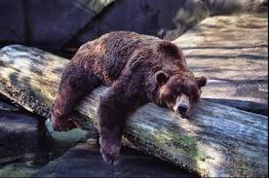
Hibernation
Reduced metabolic rate
Fat storage and utilization
Cold induced diuresis
Low body temperature
It is common among higher animals
It is mostly seen in mammals such as bats, hedgehogs and ground squirrels.

Slide 5
STAGES OF HIBERNATION
Preparing for hibernation
Going into hibernation
Arousal period

Slide 6
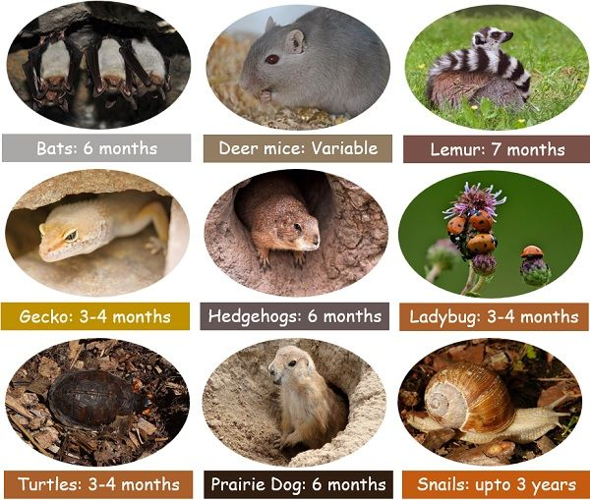
EXAMPLES OF ORGANISMS AND THEIR HIBERNATION PERIOD

Slide 7
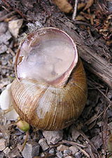
AESTIVATION
Reduced metabolic rate
Lowered body temperatures
Water conservation
Fat storage
Occurs mostly during summer
Organisms look for a moist, cool and shady place to sleep

Slide 8
AESTIVATION CONT’D
It prevents excessive water loss and internal body damage due to high temperatures
It takes place in cold blooded animals like snails, earthworms and frogs

Slide 9
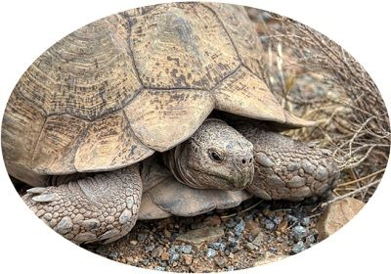
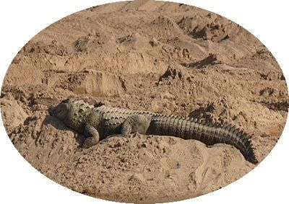
EXAMPLES
Aestivation of desert tortoise
Aestivation of crocodile

Slide 10
DIAPAUSE
Developmental arrest
Metabolic suppression
Changes in hormone levels
Tolerance to environmental stressors
Anti-desiccation mechanisms
Examples of insects that undergo diapause include flesh fly, southwestern corn borer etc.

Slide 11
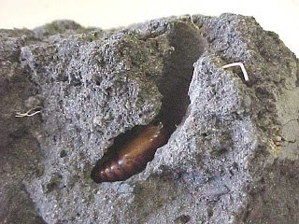
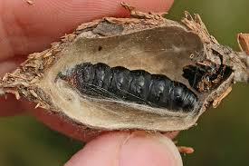
EXAMPLES OF ORGANISMS
Cotton bollworm
(Helicoverpa amiga)
Evergreen Bagworm
(Thyridopteryx ephemeraefomis)

Slide 12
CONCLUSION
Hibernation, aestivation and diapause are adaptive mechanisms some organisms undergo to survive in harsh environmental conditions. They undergo this adaptive mechanisms to maintain their internal heat, to conserve energy and to prevent internal damage.

Slide 13
THANK YOU

Slide 14
REFERENCES
https://www.britannica.com/science/hibernation
https://www.sciencedirect.com/topics/agricultural-and-biological-sciences/aestivation
https://www.google.com/amp/s/www.geeksforgeeks.org/difference-between-aestivation-and-hibernation/amp/

